Slide 1

Module 6-Concept Development and Testing Office Hours with Raunak Goyal Nov 18, 2023

Slide 2



AGENDA
Module 6 Review
Assignment 4.2 Example
Assignment Discussions
Additional Resources
Programme Schedule
Next Week
Q&A
Notes:
In today’s session we will cover the following topics:
Getting Help
Week 3 Assignment Review
Module 5 Review
Assignment Discussions
Additional Resources
Programme Schedule
Next Week
Q&A

Slide 3
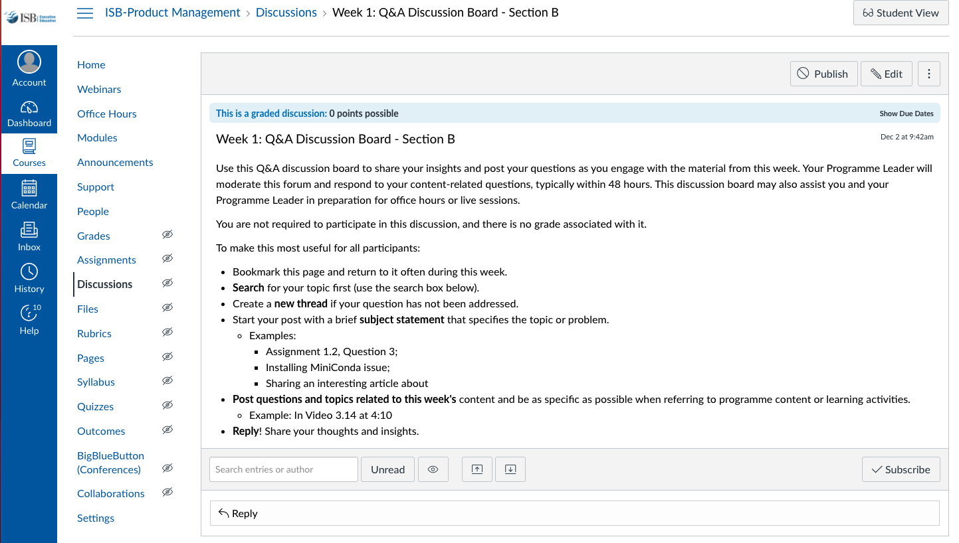
GETTING HELP
Notes:
While I covered this last week, I will continue to cover how to get help for a few more modules.
One of the best resources are your classmates. A great way to learn from them is to engage on the weekly discussion topic. We want to broadly encourage collaboration, though without plagiarism. Share your thoughts, concepts, pluses and minuses though not your actual answers.
These are accessible in the weekly module, though I have highlighted the page where you will be taken.
It is great that many of you are setting up study groups via WhatsApp. We encourage that independent initiative and effort, while the programme leaders can not participate in those groups, we will engage in the group discussions on Canvas. What we will also do is provide some of the additional resources we reference in office hours in these discussions.

Slide 4
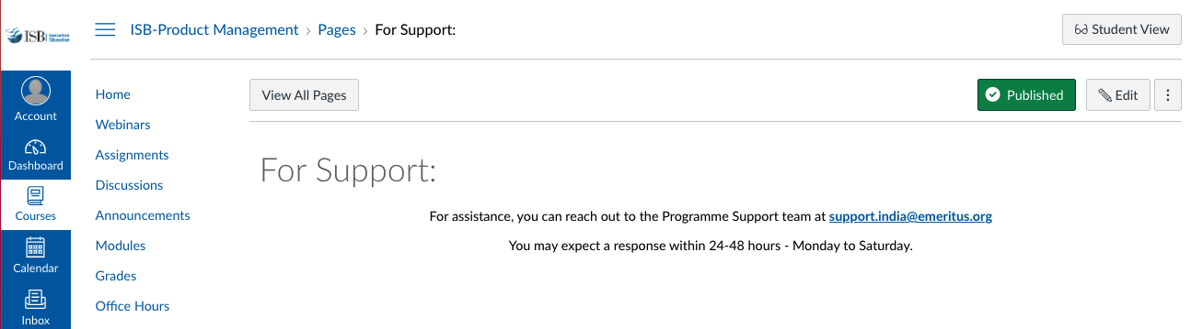
GETTING HELP
Notes:
And for content or assignment related material CLICK
You can reach out to your programme leader via an Inbox email for help. CLICK
Then for support for Canvas and other technical items contact support. This generally includes grading and associated scheduling and requests. When you click the Support tab it takes you to this page. Note that you are asked to send an email to programme.support@eruditus.com. For those of you who may not be in India, note the spelling of program.

Slide 5
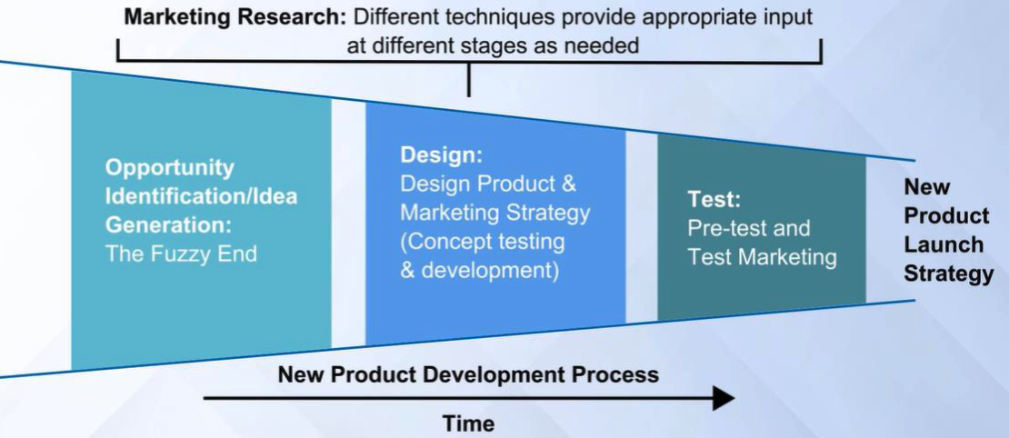
MODULE REVIEW – NEW PRODUCT DEVELOPMENT
Notes:
This week we start after the “Fuzzy Front End” and take a look at a bit more of the process at a high level.

Slide 6
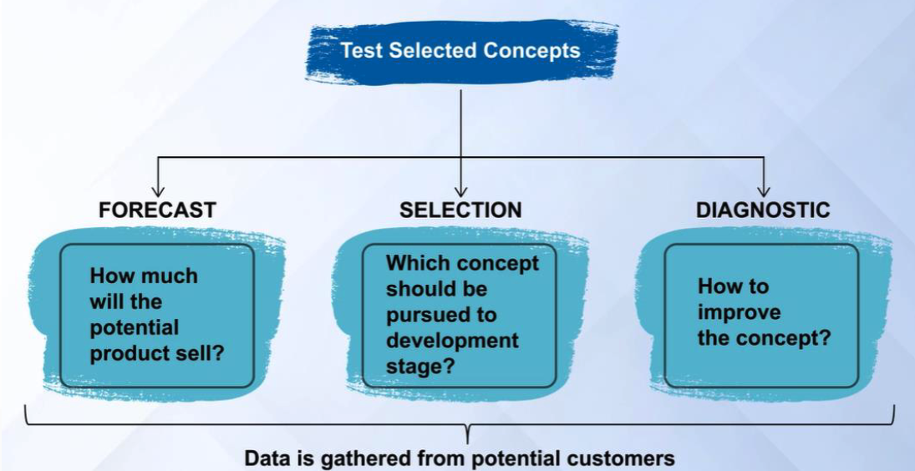
MODULE REVIEW – CONCEPT TESTING
Notes:
Here are some methods to test the product concept:
Forecast – How much will the product sell?
Selection – Which concept should be pursued in the development stage?
Diagnostic – How to improve the concept?

Slide 7
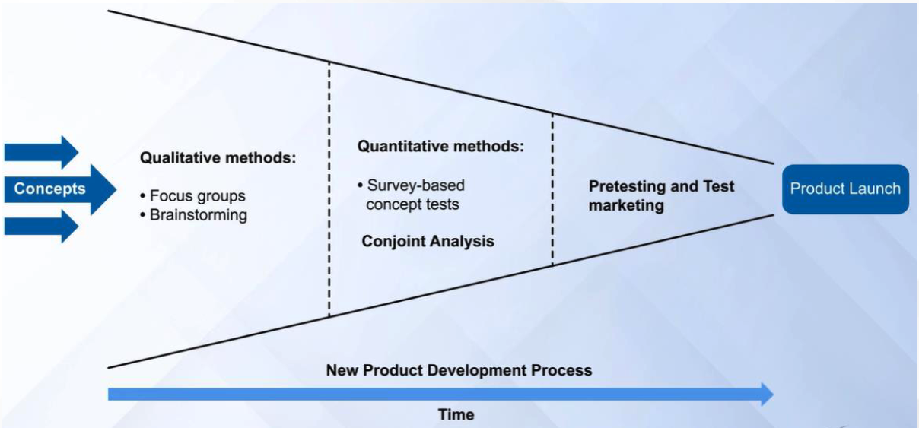
MODULE REVIEW – CONCEPT TESTING
Notes:
Here are some of the ways to test concepts at different phases of the New Product Development Process
In the Fuzzy Front End/Opportunity Identification phase – Focus Groups and Brainstorming
In the Design Phase – Survey Based Concept Tests
In the Test phase – Pretesting, i.e. Alpha, Beta product test, along with test marketing.

Slide 8
MODULE REVIEW – 7 STEP METHOD
Define the purpose of the concept test
Choose a survey population
Choose a survey format
Communicate the concept
Measure customer response
Interpret the results
Reflect on the results and the process
Notes:
From the lectures, Professor Siddharth laid out the 7 step method of product concept testing. These are:
CLICK
1.Define the purpose of the concept test. CLICK
2.Choose a survey population CLICK
3.Choose a survey format. CLICK
4.Communicate the concept. CLICK
5.Measure customer response. CLICK
6.Interpret the results. CLICK
7.Reflect on the results and the process

Slide 9


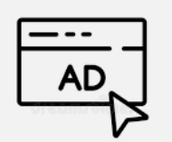



CONCEPT TESTING USE CASES
Name Testing
Ad Testing
Product Testing
Logo Testing
Messaging Testing
Package Testing
Notes:
Coming up with a name that’s both catchy and relevant is tough. Better to ensure consumers get the meaning
CLICK
Choose a logo that differentiates your product and stands out on the shelves.
CLICK
Ensure that your advertising campaigns are on target before you launch.
CLICK
Understand how your future customers will respond to product ideas before they go to market.
CLICK
Listen to how consumers react to your package design to ensure it will stand out on the shelves.
CLICK
Make sure your copy and claims explain your product and convince people to buy it.
CLICK

Slide 10

FORMULATING CONCEPT TESTING QUESTIONS
Each different type of concept testing comes with its own subset of suitable goals
Purpose of Goals
Quantifying how likely this product is to be purchased by the existing/newly identified market.
Determining how well this product will stand out among competitors’ products on shop shelves.
Discovering which feature would most likely encourage current customers to renew their membership, subscription or purchase with you.
New Model Vacuum Cleaner
Concept validation questions:
To what extent do you like or dislike this product?
How appealing are the following features?
Which of the following attributes is most important to you?
How well do the following statements describe the product?
Screening Questions
Which of these statements applies to you?
I do the vacuuming in my home
I do not do the vacuuming in my home
Notes:
Each different type of concept testing comes with its own subset of suitable goals – your surveys should aim to satisfy these goals with answers from consumers.

Slide 11
CONCEPT TESTING, WHEN?
Development | Introduction | Growth | Maturity | Saturation | Decline
Product Ideas Names Logos Packaging | Ads Claims Messaging Taglines | Product Ideas Names Logos Packaging | Ads Messaging Line Extensions | Ads Rebranding New Products | Messaging Rebranding New Products
Notes:
The beauty of concept testing is that it’s flexible. It can be done at any stage of a product in its life cycle.

Slide 12
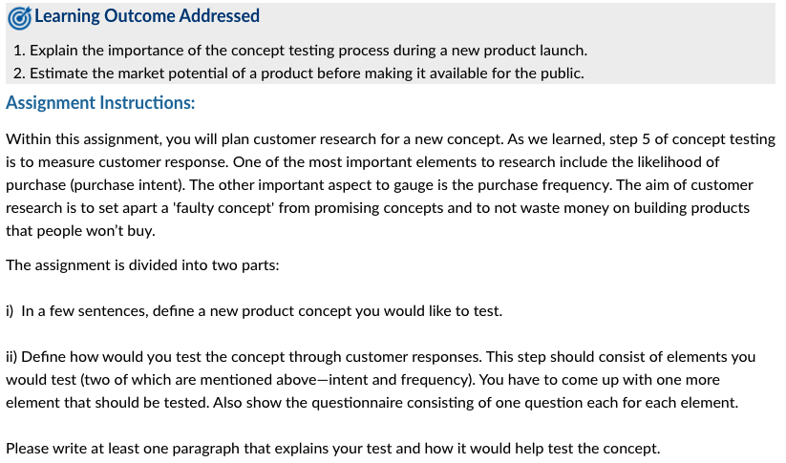
ASSIGNMENT 6.3 PROBLEM
Notes:
Learning Outcome Addressed
Explain the importance of the concept testing process during a new product launch.
Estimate the market potential of a product before making it available for the public.
Assignment Instructions:
CLICK
Within this assignment, you will plan customer research for a new concept. As we learned, step 5 of concept testing is to measure customer response. One of the most important elements to research include the likelihood of purchase (purchase intent). The other important aspect to gauge is the purchase frequency. The aim of customer research is to set apart a 'faulty concept' from promising concepts and to not waste money on building products that people won’t buy.
The assignment is divided into two parts:
CLICK i) In a few sentences, define a new product concept you would like to test. ii) Define how would you test the concept through customer responses. This step should consist of elements you would test (two of which are mentioned above—intent and frequency). You have to come up with one more element that should be tested. Also show the questionnaire consisting of one question each for each element.
CLICK
Please write at least one paragraph that explains your test and how it would help test the concept.

Slide 13
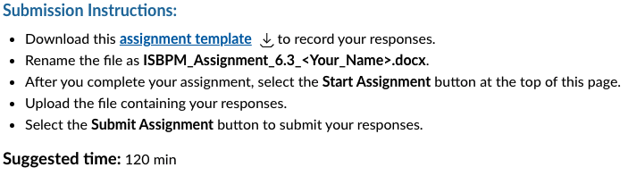
ASSIGNMENT 6.3 SUBMISSION
Notes:
For this assignmant
The Submission Instructions:
CLICK
Download this assignment template Download assignment templateto record your responses.
Rename the file as ISBPM_Assignment_6.3_<Your_Name>.docx.
After you complete your assignment, select the Start Assignment button at the top of this page.
Upload the file containing your responses.
Select the Submit Assignment button to submit your responses.
And CLICK
Suggested time: 120 min
Let’s take a look at the items on the template and use that for discussion.

Slide 14
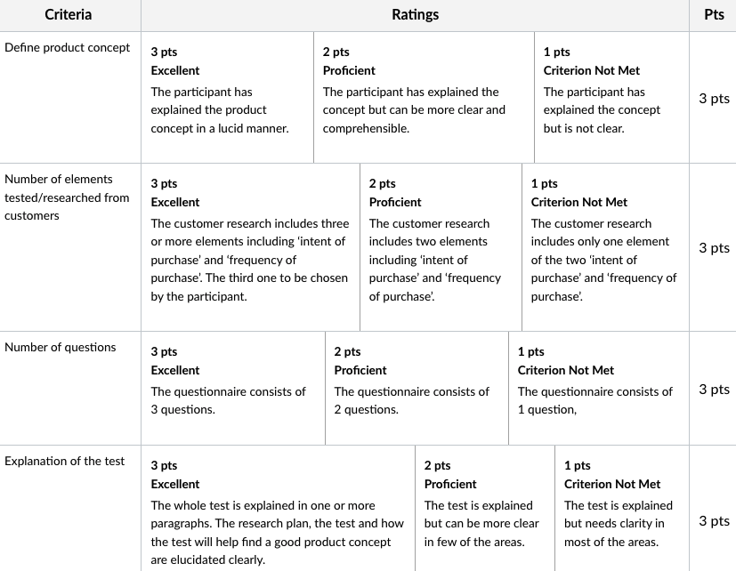
ASSIGNMENT 6.3 Rubric
Notes:
This assignment
CLICK
has a total of 4 criteria, each worth 3 points for a total of 12 points.
We’ll use each of the criteria for the discussion . . .

Slide 15
ASSIGNMENT 6.3 Criteria
Define product concept
Number of elements tested/researched from customers
Number of questions
Explanation of the test
Notes:
CLICK
Define product concept
CLICK
Number of elements tested/researched from customers
CLICK
Number of questions
CLICK
Explanation of the test

Slide 16
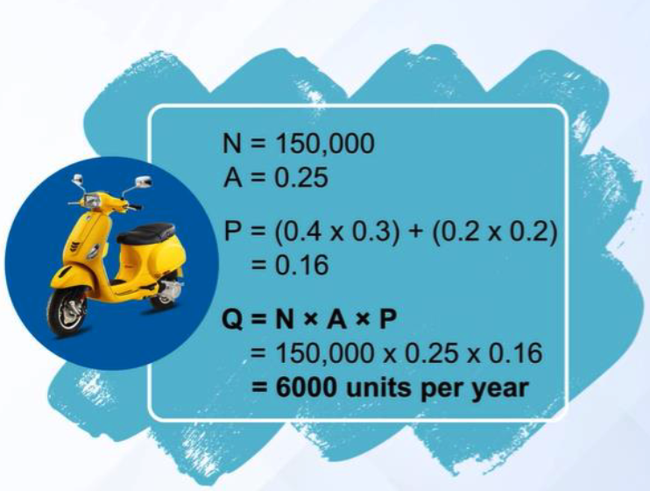
MODULE REVIEW – SALES FORECAST
Notes:
In the lectures the professor provided a number of great formulas and methods to perform a sales forecast. Here is one example:
Q = N x A x P
Q = The quantity of product expected to be sold during a period of time
N = The number of potential customers expected to make purchases during a time period
A = The Fraction of these potential customers or purchases for which the product is available and the customer is aware of the product
P = The Probability that the product is purchased if available and if the customer is aware of it.
While a formula is great, note that each of the variable may not be fixed.
To change N, consider alternative markets for the product and their size
To change A, consider how distribution and promotional plans will impact the sales
To change P, consider changes to the product design that would impact sales or advertising that improves product attractiveness.

Slide 17
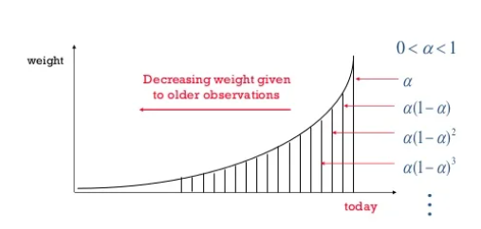
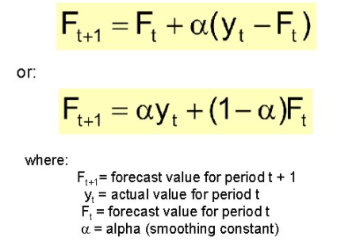
SIMPLE EXPONENTIAL SMOOTHING
The higher is the value of α (i.e. the nearer to 1), the forecast becomes more sensitive to latest observations.
The lower is the value of α (i.e. the nearer to 0), forecast will be less sensitively to latest observations.
Simple exponential forecast technique can not cope up with trends and seasonality present is time series.

Slide 18
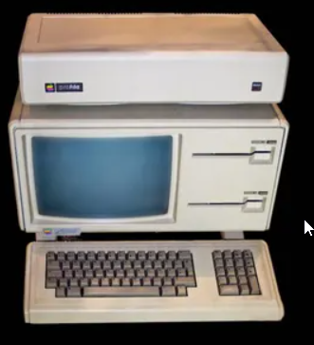
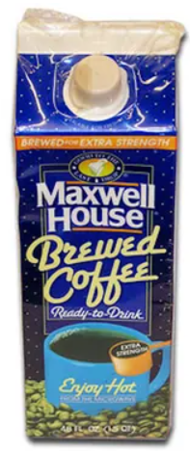
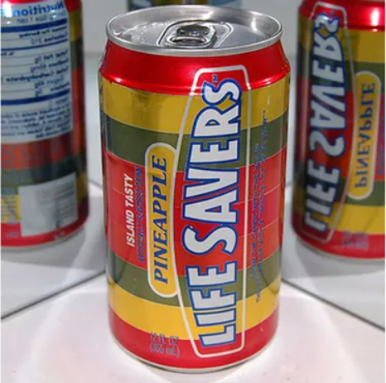
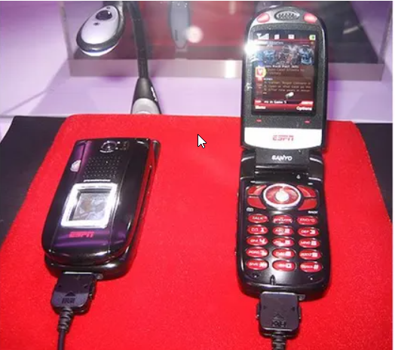
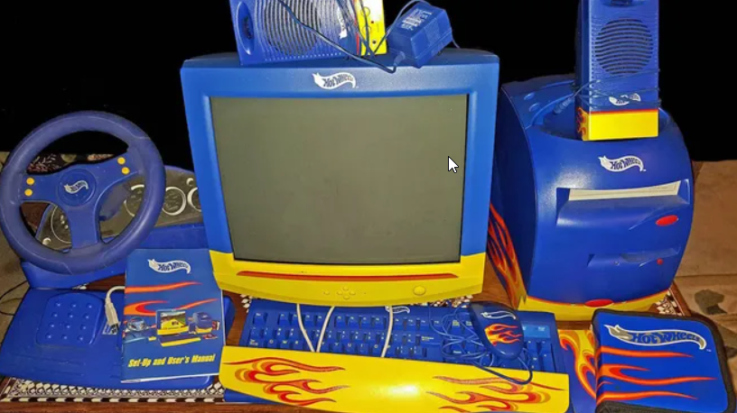
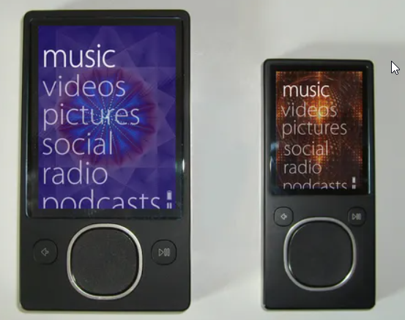

FAILED PRODUCT CONCEPTS QUIZ
Notes:
https://www.usatoday.com/story/money/2018/07/11/50-worst-product-flops-of-all-time/36734837/
We’ll share with you an article on product concepts that failed. The items in this quiz may be a little self evident and a bit US centric though I’d ask everyone to give their guesses about the name of the product and company.
CLICK
Life Savers Soda - Though Life Savers soda tested well in focus groups, it failed to gain traction with the broader consumer market. Many attribute the soft drink’s failure to the prevailing perception that it was liquid candy. The soda was available in some of the candy’s popular fruit flavors, including pineapple, orange punch, grape punch, and lime punch. Life Savers did not release a mint flavored soda, however.
CLICK
Mobile ESPN - In 2006, ESPN attempted to capitalize on the desire of sports fan to have access to sports stats, scores, and video on the go. Mobile ESPN required users to buy a specific phone, which would include access to ESPN content as part of the subscription. However, the only phone Mobile ESPN offered, a Sanyo, cost $400, and the service was $40 per month, too rich for many sports fans. The service shut down within a year. Disney, ESPN’s parent company, spent $150 million on the failed venture.
CLICK
Apple Lisa - Before Apple hit its stride in the 2000s and became the most profitable corporation in history, the company was responsible for some of the worst product flops of all time. Designed as a high-end personal computer with a graphical user interface for business customers, the Apple Lisa took three years and $50 million to develop before its release in 1983. However, the computer’s $9,995 price tag, which is equivalent to roughly $25,000 today, was too high for many consumers. After selling just 100,000 units in two years Apple discontinued the Lisa in 1985.
CLICK
Maxwell House Pre-brewed coffee - Maxwell House Brewed Coffee was pre-brewed coffee sold in a carton with a picture of a hot mug of coffee on the packaging, a misleading visual cue for a product meant to be stored in the refrigerator. Adding to the product’s issues, the carton was lined with foil and could not be microwaved. For a product marketed for its convenience, this was an especially problematic feature for consumers. The product was discontinued shortly after it was released.
CLICK
Hot Wheels and Barbie Computers - In 1999, Mattel announced that it had entered a licensing agreement to sell Barbie and Hot Wheels computers. The computers would be manufactured and sold by the Patriot Computer Corporation, a privately held company based in Toronto. The move was part of an attempt to reconcile the declining sales of Barbie dolls and growing sales of software and CD-ROMs.
The computers, however, had many manufacturing flaws, and the resources Patriot devoted to fixing and replacing broken computers drove it out of business. By December the following year, the company had fired its 200 employees and filed for bankruptcy.
CLICK
Microsoft Bob - Microsoft released Microsoft Bob in March 1995. Intended as a simple, easy-to-use OS interface at the time, Bob presented the desktop as a house, with familiar objects corresponding with different computer applications. Clicking on the stationary lying on a desk, for example, opened the word processor. Despite its simple appearance, Bob required more processing power than most home computers had in 1995. Bob was also considered too expensive and poorly designed, and was overshadowed by the release of Windows 95 later that year. Bob was discontinued roughly a year after its release.
CLICK
Microsoft Zune - In an attempt to compete with Apple's dominant iPod MP3 player, Microsoft released the Zune in 2006. As of November 15, 2015, Microsoft discontinued all streaming, downloading, and other music services for the Zune. In the fourth quarter of fiscal 2009, Microsoft recorded a 42% decline in revenue in its non-gaming devices segment -- a decline largely attributable to the Zune’s poor performance. While the device might have been a reasonable choice for consumers, a number of reported bugs did not help sales. On December 31, 2008, most if not all 30GB Zunes stopped functioning simply because the underlying code had failed to account for the extra day in leap years.

Slide 19
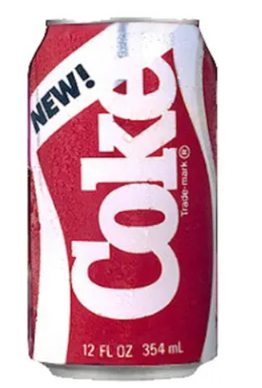
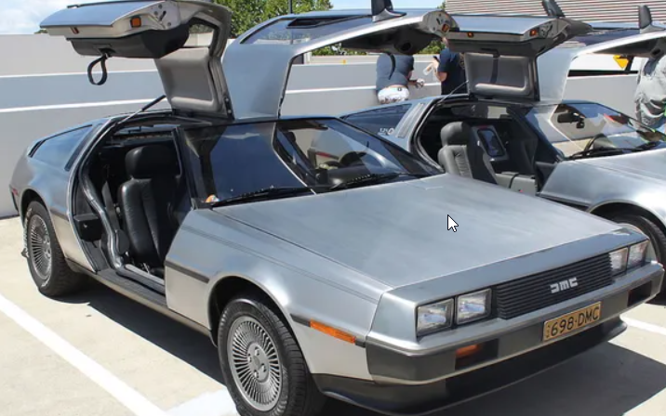

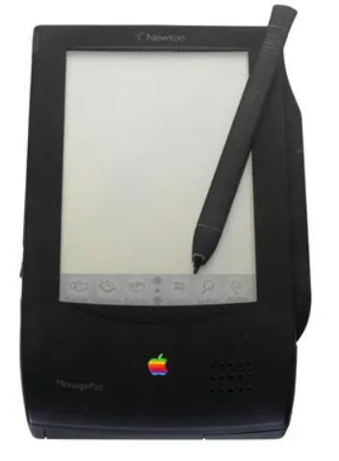
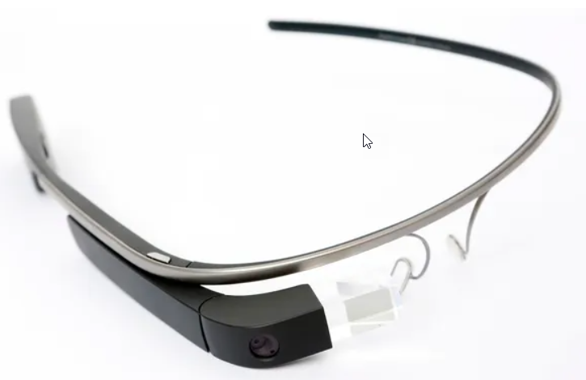
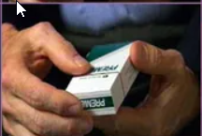
FAILED PRODUCT CONCEPTS QUIZ
Notes:
Continuing with a few more . . .
CLICK
DeLorean DMC-12 - In 1973, auto executive John DeLorean left General Motors to form the DeLorean Motor Company. After years of production delays, the DeLorean DMC-12 was released in January 1981. The car’s unique design was poorly received, however, and by 1982 less than half of the 7,000 DeLorean units produced had been sold. The DeLorean is widely recognized due to its use as a converted time machine in the “Back to the Future” series. However, the first of these films was released in 1985, far too late to save the ill-fated brand. DeLorean filed for bankruptcy in 1982.
CLICK
Windows Vista - Introduced in 2007 as a follow-up to Windows XP, the Windows Vista operating system was everything its popular predecessor was not -- in all the wrong ways. Panned by customers and IT professionals alike, Vista reduced PC performance and caused a number of internet problems for users. As a result, Dell began offering Windows XP again on new laptops a few short months after Vista was introduced. Windows announced this month that it would no longer provide support for Vista, driving the final nail into the operating system’s coffin.
CLICK
New Coke - Over the 15 years leading up to 1985, Coca-Cola’s flagship cola drink had been losing market share to Pepsi Cola. To compete, the company changed the drink’s formula for the first time in 99 years -- but the move today is considered one of the greatest flops of all time. New Coke was met with public outrage and lasted only a few months. The company reintroduced its older formula, rebranded as Coca-Cola Classic.
CLICK
RJ Reynolds Premier Smokeless Cigarettes - R.J. Reynolds, the second largest U.S. tobacco company, began marketing in 1988 a smokeless tobacco product that was intended to be a safer way to use a cigarette. In addition to concerns over the product's actual safety, smokers missed the familiar elements of traditional cigarettes -- the smoke, the burn, and the flick. Another issue was the widely-reported unpleasant chemical taste, which one user described as resembling “burning plastic.” Reynolds sunk close to $1 billion into the product before pulling it off the market within a year.
CLICK
Apple Newton - While the personal digital assistant would become a popular consumer electronics product in the late 1990s, the first PDA was one of the biggest product flops of all time. One year after Apple CEO John Sculley coined the term “PDA” in 1992, the company released the Newton MessagePad. While the device incorporated innovative technology such as a pen-based touch screen and the ability to sync with software on a personal computer, Apple sold only 50,000 units of the product in its first four months on the market. The Newton product line was discontinued in 1998.
CLICK
Google Glass - Google first announced Google Glass -- an eyeglasses shaped head-mounted display with smartphone capabilities -- to the public in 2012. The announcement began with a statement of principle: “We think technology should work for you -- to be there when you need it and get out of your way when you don’t.” After two years of disappointing sales, it was clear consumers did not need Google Glass. Google stuck to its principle, and in 2015 discontinued the product’s development. Privacy concerns, reported bugs, low battery life, bans from public spaces, and an inability to live up to the hype all stymied public adoption of the technology.
While that it interesting, all the companies had tested the concepts, yet they failed. Consider what they could have done to prevent those failures.

Slide 20
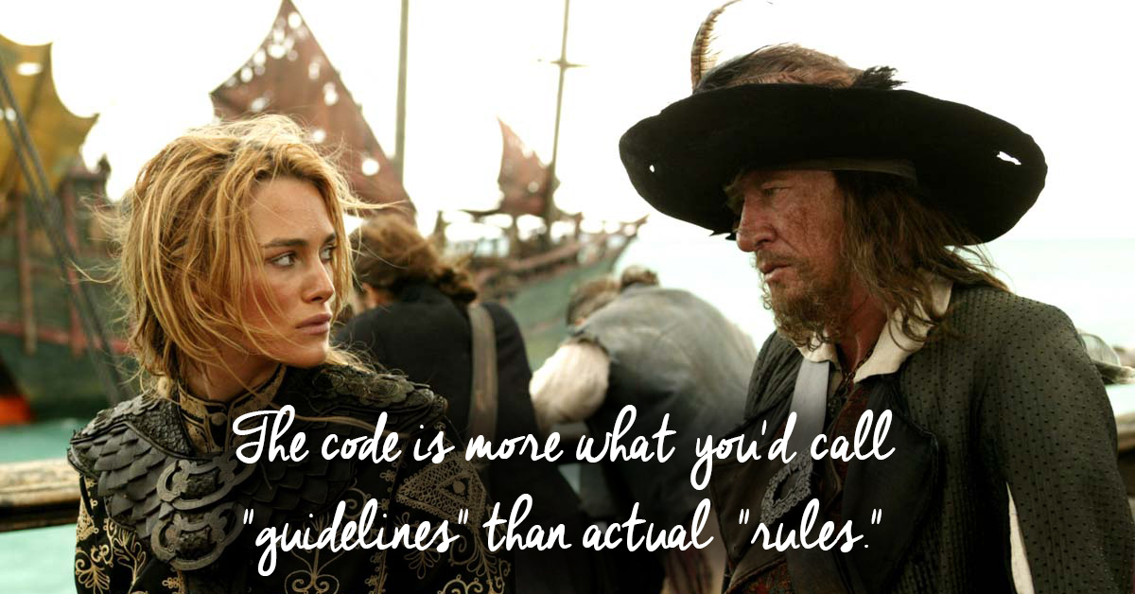
GENERAL COMMENTARY - JUDGMENT
Notes:
Note that after professor Siddharth walked through a number of calculations he said “use your judgement”
While the tools are great, they do not provide the one and only answer. They are meant to provide perspective on the problem, gain insight and help you make an informed judgement.
CLICK
I am a fan of the movie Pirates of the Caribbean. Those of you that have seen the movie will understand the quote:
The code is more what you’d call “guidelines” than actual “rules”.
This is the judgment that the professor refers to. The big difference between being an analyst and a product manager is a product manager needs to provide a recommended course of action. This is the value add of a product manager.

Slide 21
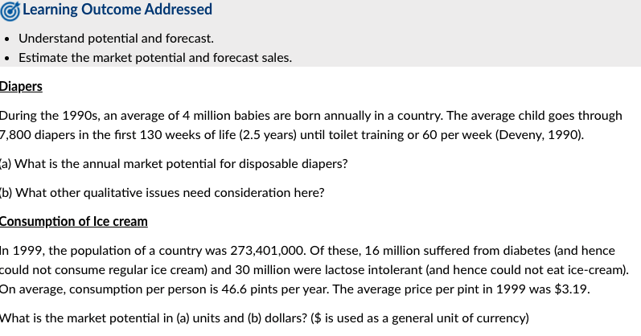
ASSIGNMENT 6.4 PROBLEM
Notes:
Learning Outcome Addressed
Understand potential and forecast.
Estimate the market potential and forecast sales.
For this problem there are 2 sections
CLICK
Diapers
During the 1990s, an average of 4 million babies are born annually in a country. The average child goes through 7,800 diapers in the first 130 weeks of life (2.5 years) until toilet training or 60 per week (Deveny, 1990).
(a) What is the annual market potential for disposable diapers?
(b) What other qualitative issues need consideration here?
And CLICK
Consumption of Ice cream
In 1999, the population of a country was 273,401,000. Of these, 16 million suffered from diabetes (and hence could not consume regular ice cream) and 30 million were lactose intolerant (and hence could not eat ice-cream). On average, consumption per person is 46.6 pints per year. The average price per pint in 1999 was $3.19.
What is the market potential in (a) units and (b) dollars? ($ is used as a general unit of currency)

Slide 22
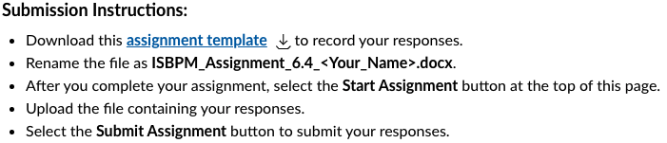
ASSIGNMENT 6.4 SUBMISSION
Notes:
For this assignment
The Submission Instructions:
CLICK
Download this assignment template Download assignment templateto record your responses.
Rename the file as ISBPM_Assignment_6.4_<Your_Name>.docx.
After you complete your assignment, select the Start Assignment button at the top of this page.
Upload the file containing your responses.
Select the Submit Assignment button to submit your responses.
There are a total of 5 points for this exercise across the two components. Let’s discuss each of these:

Slide 23
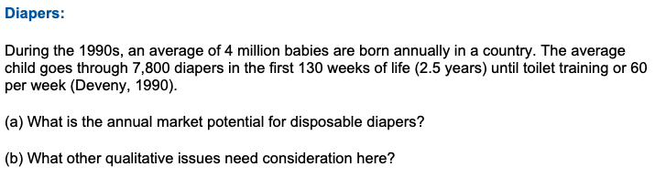
ASSIGNMENT 6.4 - DIAPERS
Notes:
Let’s take each of these compoents individually:
CLICK
What is the annual market potential for disposable diapers?
CLICK
What other qualitative issues need consideration here?
Now for the second question
----------SOLUTION------------------------- During the 1990s, an average of 4 million babies were born annually in the country. The average child goes through 7,800 diapers in the first 130 weeks of life (2.5 years) until toilet training or 60 per week (Deveny, 1990). Thus, the annual market potential for disposable diapers is [(2.5)(4 million) babies][60 diapers/week][52 weeks/year] = 28.7 billion/year The figure includes: (1) Babies who are allergic to diapers (2) households using cloth diapers (these are still potential customers).

Slide 24
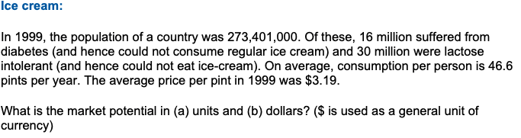
ASSIGNMENT 6.4 – ICE CREAM
Notes:
This has 2 components also:
CLICK
What is the market potential in Units?
CLICK
What is the market potential in Dollars?
-----------SOLUTION---------------------
Solution: In 1999, the population was 273,401,000. Of these 16 million suffered from diabetes (and hence could not consume regular ice cream) and 30 million were lactose intolerant. Removing these leaves 227,401,000 potential customers (plus those who are both diabetic and lactose intolerant). On average, consumption per person is 46.6 pints per year. This means potential is 10.5 billion pints per year which, at an average price per pint of $3.19, translates into a $33.5 billion dollar market.

Slide 25
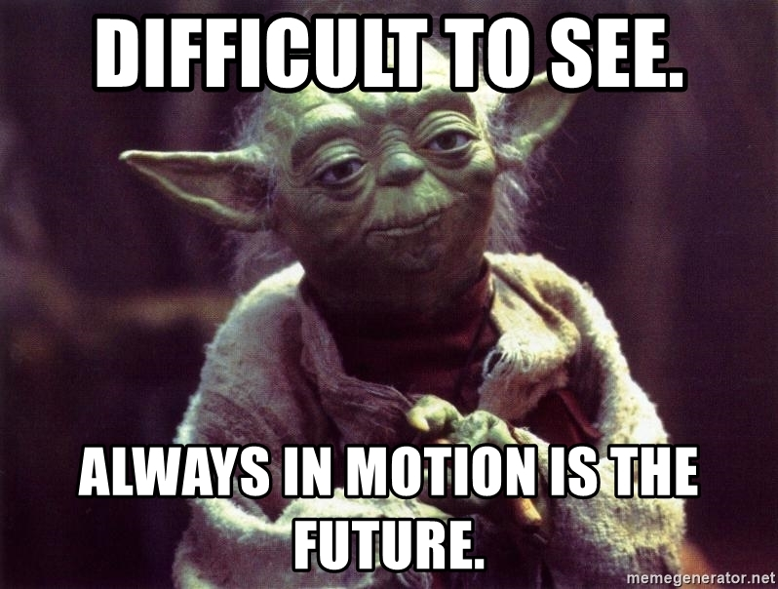
MODULE REVIEW – FORECASTING
Prediction is very difficult, especially if it's about the future!
Niels Bohr
Notes:
The famous physicist Niels Bohr once said, “Prediction is very difficult, especially if it's about the future!”
I kind of prefer memes
CLICK
Difficult to see. Always in motion is the future.

Slide 26
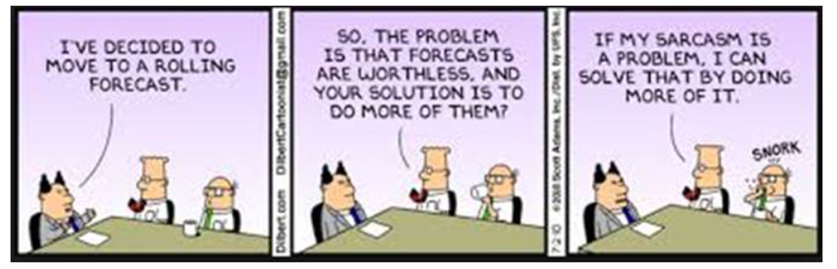
MODULE REVIEW – FORECASTING
Notes:
And a bit of humor, I hope this Dilbert cartoon translates well.

Slide 27
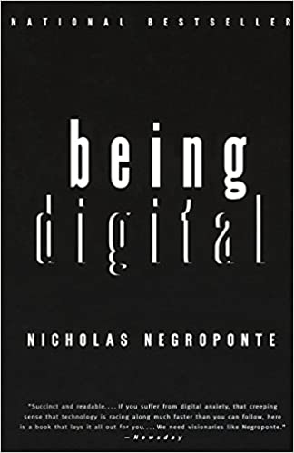
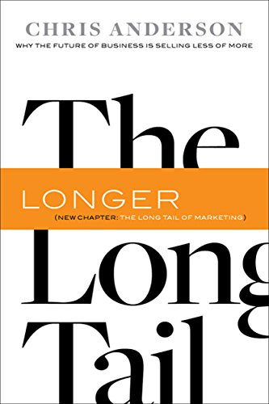
ADDITIONAL RESOURCES
Notes:
For additional resources this week consider the book
CLICK
Being Digital by Nicholas Negroponte.
It is about the disruption that ”will” occur due to products transitioning from Atoms to Bits. Professor Siddharth gave a great example in video 7 where he discussed how DVDs available for local rental were somewhat limited due to shelf space.
https://amzn.to/34clXXh
This technical disruption enabled the book mentioned by professor Siddharth
CLICK
The Long Tail: Why the Future of Business is Selling Less of More by Chris Anderson
Basically, "The Long Tail" lays out: the rise of the niche enabled by the technical disruption of converting “Atoms to Bits”. The Long Tail is really about the economics of abundance. New efficiencies in distribution, manufacturing, and marketing is changing what's commercially viable across the board.
https://amzn.to/3rqCU9K

Slide 28
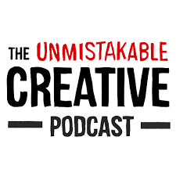


ADDITIONAL RESOURCES
Notes:
So, what does it take to create a Niche? Of course, “it depends”, though here is some guidance
CLICK
Kevin Kelly wrote a very popular blog article titled 1000 True Fans.
In the article he says that to make a living as a craftsperson, photographer, musician, designer, author, animator, app maker, entrepreneur, or inventor you need only thousands of true fans.
A true fan is defined as a fan that will buy anything you produce.
https://kk.org/thetechnium/1000-true-fans/
There is a popular podcast and associated blog
CLICK
The Unmistakable Creative with Srinivas Rao
He published a blog article just a few weeks ago, How to Build and Audience of 1000 True Fans in a Noisy World
https://unmistakablecreative.com/1000-true-fans/
If you do a search on the term “1000 True Fans” you will find lots of discussion on the topic . . . Even though the original article was published 14 years ago.
The one Kevin Kelly likes is
1000 True Fans, try 100 by Li Jin
https://future.a16z.com/1000-true-fans-try-100/

Slide 29
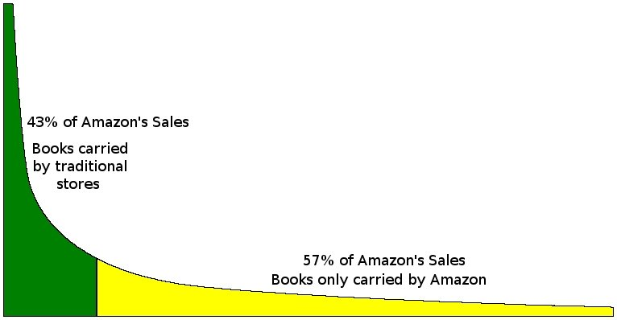
QUESTIONS FROM DISCUSSION BOARDS & IN-BOX
My understanding of Long Tail effect is that it's not about a single product or product feature.
Notes:
That is correct. Here is a chart about book on the Amazon site. Amazon is the largest book store in the world. Though let’s take a look at this from 2 perspectives:
First, I suspect that this chart was for physical books that would be in an Amazon Warehouse. Pretty impressive, though it still has a physical manifestation which means the books need to be moved from a far away warehouse in order to ship.
Now consider the same concept digitally. There has been a conversion of atoms, the books, to bits, the digital version of the product, which could then be shipped to the persons eBook reader like a Kindle immediately. This is the dramatic transformation envisioned

Slide 30
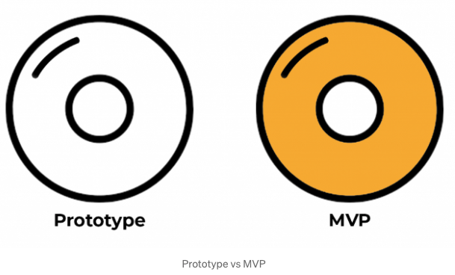
QUESTIONS FROM DISCUSSION BOARDS & IN-BOX
Should concept testing be completed before MVP development process? Or can it happen in parallel?
Notes:
Should concept testing be completed before MVP development process? Or can it happen in parallel?
Concept testing happens at all phases of the New Product Development process, so the answer is actually both before and in parallel depending on the situation. That is why it is the Fuzzy Front End. You may create a product before any true concept testing . . . Or it could be the opposite.
Consider the example from last week
CLICK
A prototype was used to test the concept on the way to an MVP.
Sometime a customer will come to you with a concept, i.e. add this feature and we will buy 1000. That is the other example.
Though, once you have an MVP things should be happening in parallel as you then have a feedback loop with customers that are willing to purchase.

Slide 31
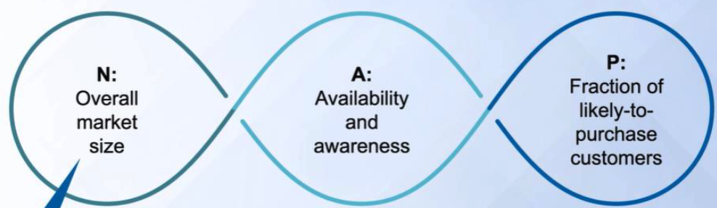
QUESTIONS FROM DISCUSSION BOARDS & IN-BOX
What is the sales forecast for a new product, which has not yet been in the market? What happens to the value of N in the equation
Q = NxAxP?
Notes:
What is the sales forecast for a new product, which has not yet been in the market? What happens to the value of N in the equation
Q = NxAxP?
While a formula is great, note that each of the variable may not be fixed.
To change N, consider alternative markets for the product and their size
To change A, consider how distribution and promotional plans will impact the sales
To change P, consider changes to the product design that would impact sales or advertising that improves product attractiveness.
Let me provide an example that we have all seen evolve over time.
In the 1980s PCs came out and they had word processors that you could buy. That was a “new” product, or was it?
Think about how people were accomplishing that function beforehand, primarily typewriters and paper.
Did the word processor take over for the typewriter? Sure, eventually. Though consider each of these variables and how things evolved over time.
For a complete typewriter replacement you had to:
Buy a computer – They were very expensive in the early 1980s
Learn how to use it and the word processor – Before the Mac everything was command line driven and there was a significant learning curve.
Buy a printer – These were expensive too, and you may need special paper, etc.
So, N in the equation would be the number of people using typewriters. At the time, IBM was the largest manufacturer of typewriters.
A is the availability and awareness. Initially people did not know that PCs could replace a typewriter
P would be the features that needed to evolve over time for certain segments of the population to adopt the solution. This included things like ease of use and price. Note how much less expensive computers are now, how much easier they are to use and how much better the printers are today.

Slide 32

Over to you!

Slide 33
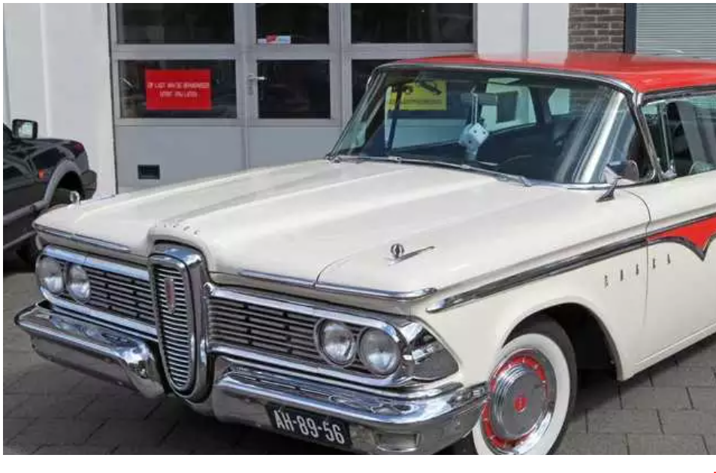
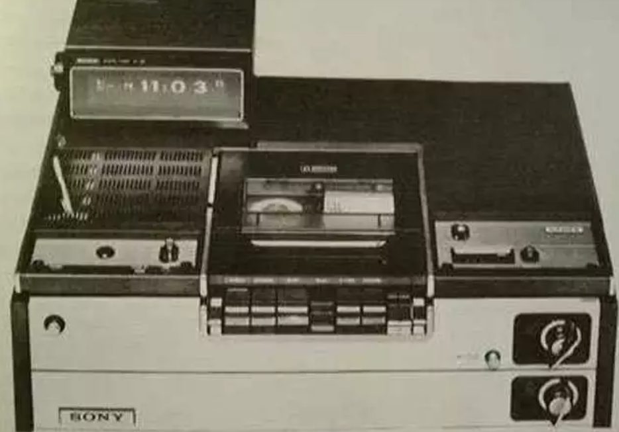
Quiz – Identify these failed brands
1975 – Sony Betamax
1957 – Ford Edsel
Notes:
Ford Edsel – times had changed from the time a concept was tested
Sony started selling the Betamax in 1975, while its rivals started releasing VHS machines

Slide 34
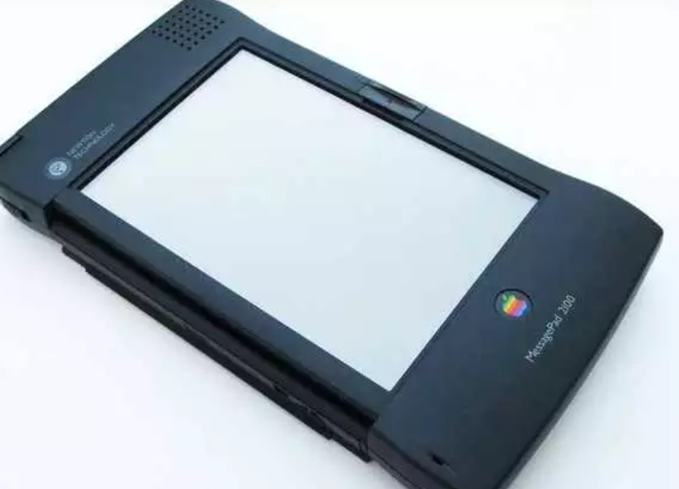
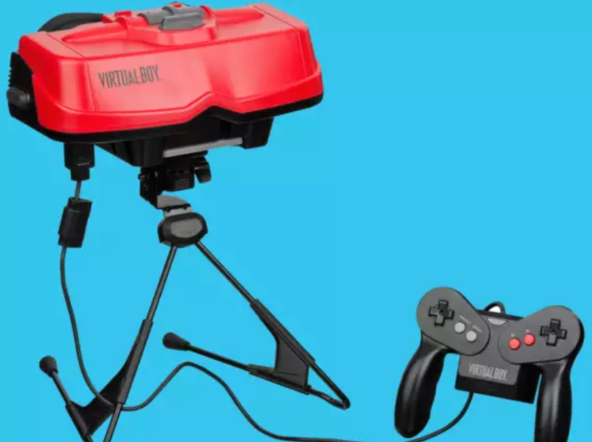
Quiz – Identify these failed brands
1993 – Apple Newton
1995 – Nintendo Virtual Boy
Notes:
Apple Newton - Its price started at $700, it was 8 inches tall and 4.5 inches wide, and its handwriting recognition was so bad.
Nintendo Virtual Boy was totally unlike what it promised. Games were little more than black and red nightmares, with low-resolution graphics and gameplay that would've been better suited to a standard game console

Slide 35
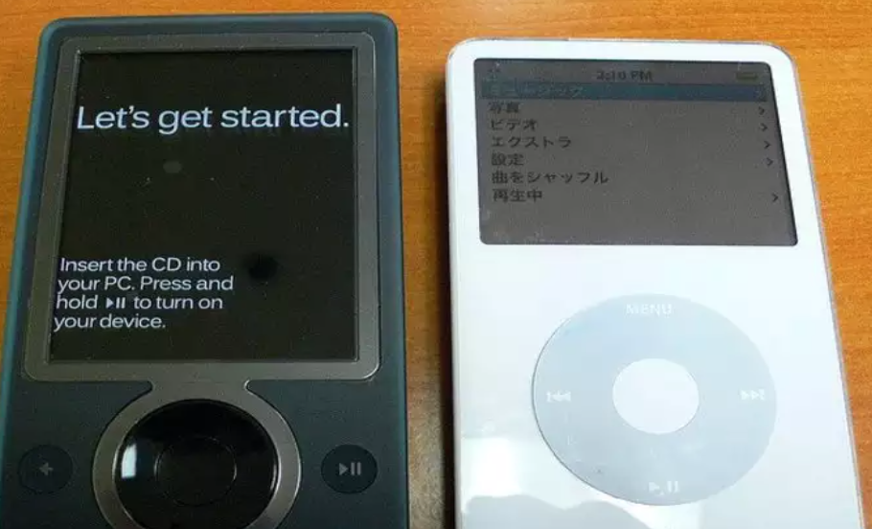
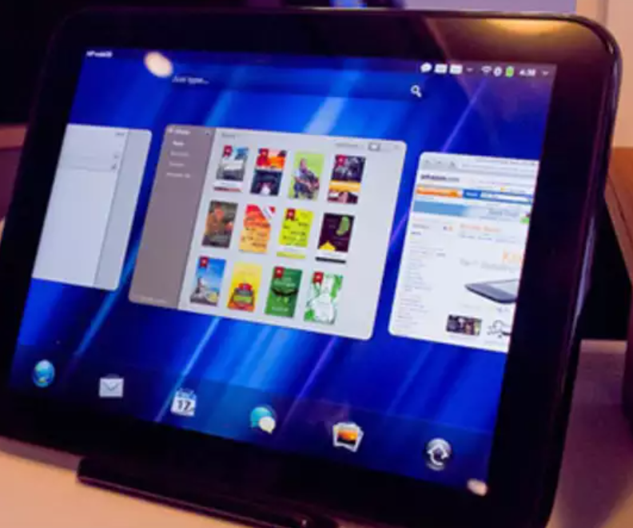
Quiz – Identify these failed brands
2011 HP Touchpad
2006 Microsoft Zune
Notes:
MS Zune - It wasn't a bad product, but it was still a chasing Apple iPod. Nobody felt a need for it.
HP Touchpad - It was rough around the edges. It just didn't really do anything better than iPad which means it's just like every other tablet out there.

Slide 36


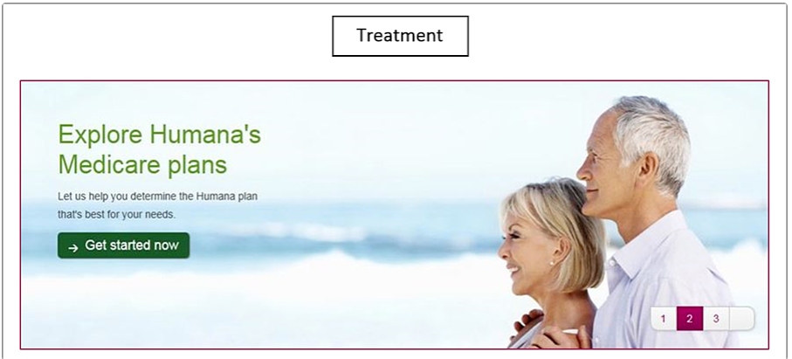

MODULE REVIEW – A/B TESTING EXAMPLE
B
A
In the control, Humana had been using a banner that displayed a lot of copy, a weak CTA, and no clear and concise message.
However, for variation B the company decided to simplify the message. This variation ended up receiving 433% more clickthroughs than the control.
With variation C, Humana switched the CTA language to include language that was a harder sell, such as "Shop." The company decided this would be a good approach because customers signing up for Medicare have a limited window to make a decision.
Notes:
As you may recall, last week we provided a few specific examples

Slide 37
MODULE REVIEW – SaaS CUSTOMER JOURNEY
Website
Product Demo
Product Purchase
Product Onboarding
Product Adoption
Support
Renewal
Website Feedback Survey
How easy was it find what you were looking for on our website?
Post Purchase Satisfaction Survey
How easy was the sales process for you?
Customer Satisfaction Survey
Which of the following product features do you like the most?
Net Promoter Score (NPS) Survey
How likely are you to recommend us to a friend?
Notes:
A lot of what we discussed was about gathering information.
Here are some surveys that are used at different points in the customer journey
CLICK
As you work on the product concept here are some surveys you may want to use at different parts of the customer journey.
Website feedback journey
CLICK
Post purchase satisfaction survey
CLICK
Customer satisfaction survey
CLICK
Net Promoter Score Survey
Now for the next required assignment

Slide 38
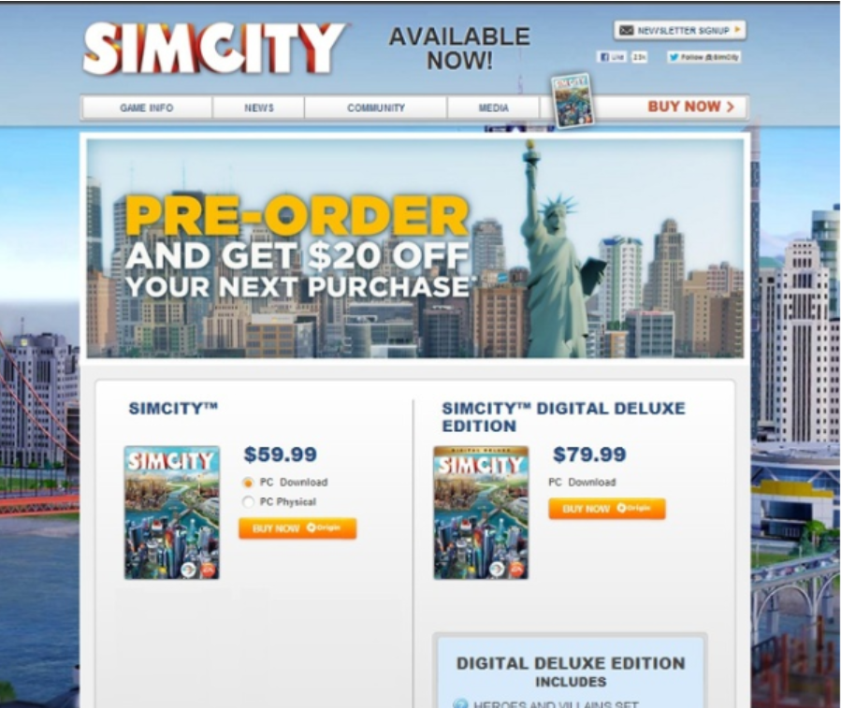
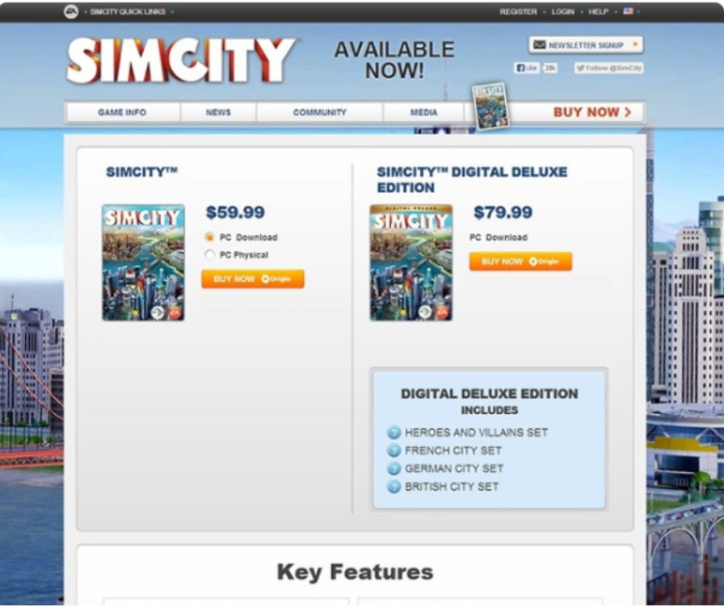
MODULE REVIEW – A/B TESTING GUESS THE WINNER
A
B
The control version of the pre-order page offered $20 off a future purchase for anyone who bought SimCity 5.
The variation eliminated the pre-order incentive.
The variation performed more than 40 percent better than the control. Avid fans of SimCity 5 weren’t interested in an incentive. They just wanted to buy the game. As a result of the A/B test, half of the game’s sales were digital.
Notes:
And this test of which offer resonated with the target customer better.
CLICK
The variation performed more than 40 percent better than the control. Avid fans of SimCity 5 weren’t interested in an incentive. They just wanted to buy the game. As a result of the A/B test, half of the game’s sales were digital.

